Slide 1
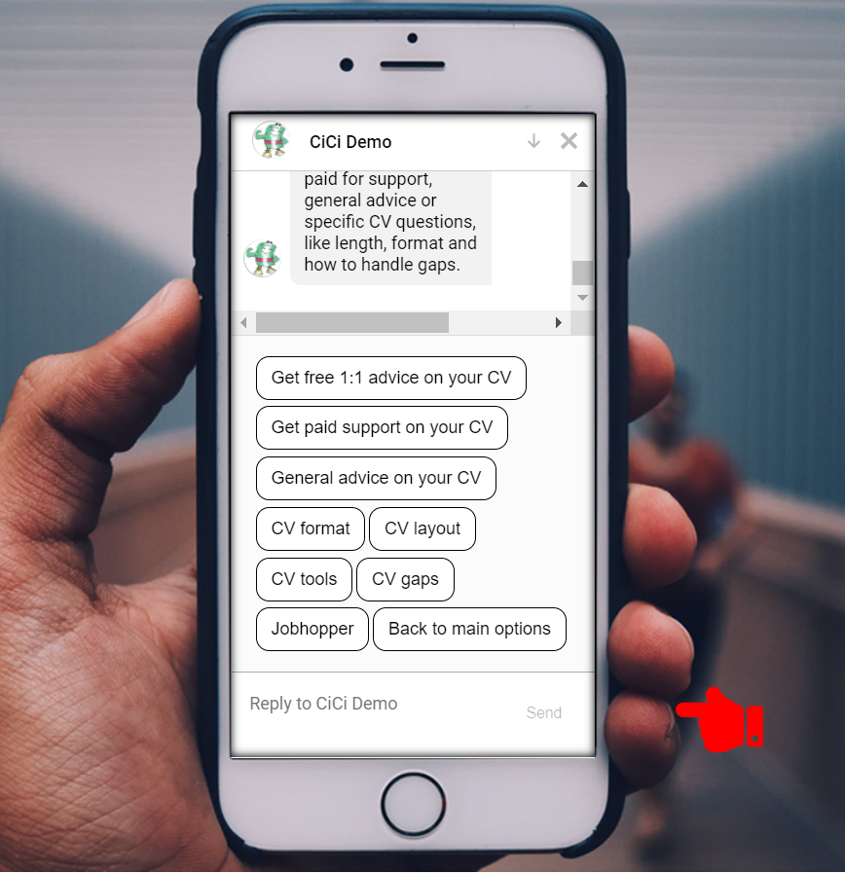

Careers Technology Supported Learning: The Bots Are Coming!
OEB Berlin 1 Dec 2021
14:30-17:30, Charlottenburg III

Slide 2
Session agenda
Welcome / Session Overview / Introduction to CiCi
What is your experience of bots (full group discussion)
A short intro to bots in education/guidance
A careers bot - what character should it have
CiCi - Chatbot demo
Using labour market info (LMI) in careers guidance
LMI needs for different clients (activity in groups)
Use cases / humans & bots working together intro
Use cases activity (activity in groups)
Wrap up and evaluation

Slide 3
1. Introduction to CiCi

Slide 4




The CareerChat Team
Our intent: To create a digital solution where individuals and practitioners can easily and quickly access trustworthy careers information, advice and guidance all in one place.
Dr Deirdre Hughes OBE
An international and national careers specialist, researcher, trainer and careers consultant
Graham Attwell, Honorary Associate Professor
A Technology Enhanced Learning specialist and researcher, focused on labour market information
George Bekiaridis
Senior bot developer and programmer, CiCi technical lead
Chris Percy
An economist and careers researcher with expertise in quantitative methods

Slide 5










CiCi so far:
Working with Partners, Practitioners and Volunteers to get the idea right
Development, testing and contracts
Tech dev seed funding from Nesta and the Department for Education (£50k)
60 careers professionals in SuperUser groups in 3 cities to shape initial design (Derby, Bristol, Newcastle)
Prototype tested by 136 volunteer users
Field testing with careers practitioners underway summer 2021
FE college-tailored implementation under contract
Discussions underway for secondary school service & a higher education pilot (initially aimed at applicants)
Recognition and coverage
UK Prize Finalist, CareerTech Challenge 2020
Shortlisted by UK Career Development Institute’s National Award for Best Practice Research and Innovation in the Use of Technology 2021
Featured in Forbes, FE News, blogs with the Institute for Employability Practitioners (IEP) and the UK Employment Related Services Association (ERSA), the IEP journal, and the Careers Matters profession magazine
Currently seeking further tech development and operational pilot partners

Slide 6

Modules live in CiCi prototype
+ more in dev plan
Discover what job you might like
CV support
Training courses
Job vacancies
Job information (including LMI)
Volunteering
Self-employment
Referral to a human adviser

Slide 7
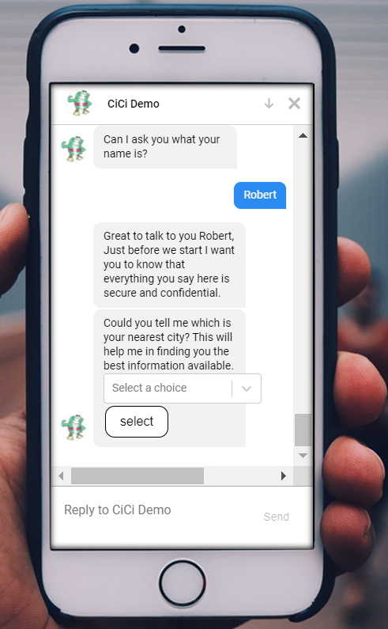
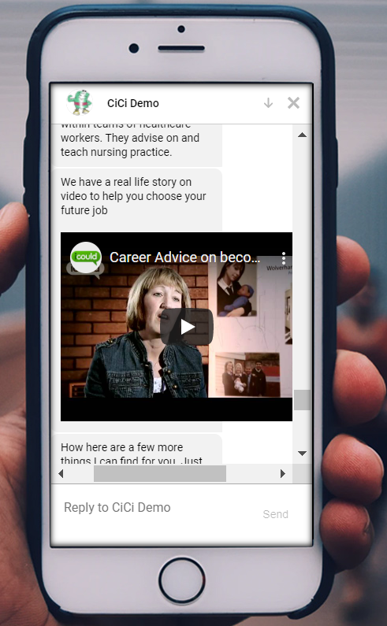
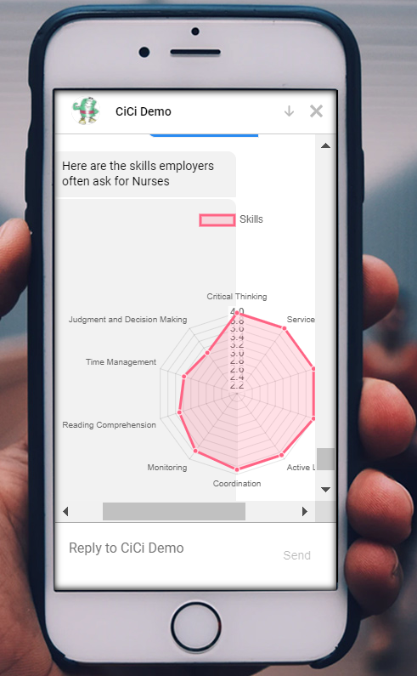

Slide 8


Early user feedback – and ongoing work
67% of testers would recommend CiCi
60% of testers said CiCi, even at prototype stage, provided a relevant response to their query
94% of practitioners said a chatbot would be a helpful complement to existing careers provision
Some key data feeds need adding, e.g. apprenticeships (added in 2021)
Need to improve look & feel (still underway)
Need to search for post-16 courses given career interests (prototype implemented for an FE college)
Need to develop guidance/functionality to support practitioner/client joint usage (plans for 2022)
“I thought it was easy to have one place for all the information and not have to scroll many different sites.”
“The skill pictures for jobs was fab! Links to extra help were readily available which is good.”
On the right track
Steers for the future

Slide 9
2. What is your experience of bots?

Slide 10
3. What character should a careers bot have?

Slide 11
CareerChat
Design your Chatbot Personality
Step 1
Google Conversation Design Process :
Brainstorm a list of adjectives (e.g., friendly, technologically competent). Focus on the qualities you want users to perceive when talking to your chatbot.
Step 3
Google Conversation Design Process:
Come up with a few different characters who embody these qualities (e.g., a barista, a fashion icon, a world traveller). Your persona doesn’t have to be a person. It could also be an anthropomorphized animal, an alien, an artificial intelligence, a cartoon character, etc.
Step 2
Google Conversation Design Process :
Narrow your list down to 4-6 key adjectives that describe your persona’s core personality traits.

Slide 12
CareerChat
Design your Chatbot Personality
Step 4
Google Conversation Design Process:
Choose one character that best embodies your chatbot and write a short description, no more than a paragraph. This description should provide a clear sense of what this character is like, especially what it would say, write, or do.
Step 5
Google Conversation Design Process:
Find, or create, an image or two that visually represents your character. Pictures are a great memory aid and can help you keep the persona in mind when writing dialogue.

Slide 13
4. A short intro to bots in education/guidance

Slide 14



The Bots In Education
POUNCE
RCT: 22% reduction in “Summer Melt”
Notes:
Talking with chatbots has become the default in a growing range of settings, particularly with large firms: booking engineers to fix faults, raising issues with a bank, or answering product questions, as well as simplifying the admin around basic interactions like ordering takeaways or checking in at airports.
Chatbots are also increasingly playing a role in education and in recruitment, moving beyond a simple “frequently asked questions” format to more sophisticated interactions.
Some Further Education Colleges are also investigating the technology; for example, Bolton College has won praise for its Ada chatbot, which delivers personalised learning and answers queries about attendance and lessons.
They are becoming commonplace in universities, with some impressive results for targeted use cases. For instance, Georgia State University ran a randomised control trial for a chatbot to answer questions from incoming students. The trial reported a 20% reduction in drop-out rates and a workload of questions answered equivalent to ten full-time staff.
In recruitment, L’Oreal has used a chatbot to help engage candidates, and has reported a high satisfaction rate. Some other large employers are also starting to explore the technology.
A chatbot revolution is underway. The premise is that simple questions should be answered by technology wherever possible, to save everyone time – both in answering questions and in getting answers as fast as possible.

Slide 15
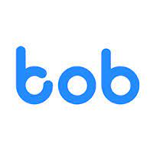
Bots for Career Guidance? Two (simplified) models
Public-facing
Chatbot-style interface for searching publicly-available data
Convenient integration of multiple databases in one place
Nudge tactics to promote users to engage and be proactive in their job search / course search
Main focus: help unemployed adults find work
Practitioner-facing
Level 1: Repository of curated, QA-ed info for guidance practitioners
e.g. LMI, trends, courses, vacancies, skills etc.
Level 2: Professional supports access for client/class
e.g. introduces tool, empowers for independent use – continues to help with reflection/action
Level 3: Integrated public/professional usage,
e.g. public front-end for simple queries
+ localised referrals + profile for action tracking
e.g. bob-emploi-.fr
e.g. careerchat.uk
Notes:
There are two different, potentially complementary design philosophies in developing chatbots to help job seekers.
The first philosophy seeks to provide a public-facing platform in which job seekers can gain answers to straightforward queries. In principle, this can take some of the burden off careers advisers and public employment services. These platforms can operate as direct query interfaces, surfacing information from a range of sources; they can also operate as personalised services, powered by an individual’s profile and log-in credentials, to manage activities like job searches and applications.
Nudge tactics can be employed, in the form of positive messaging and peer group success statistics, to help users engage and be proactive in their job search. These platforms are particularly well-suited to guiding digitally literate and proactive people to find work at low unit cost. An example is bob-emploi.fr in France.
The second design philosophy is built off a practitioner-facing approach. This philosophy hopes to empower employability professionals and support clients who might be facing more significant barriers to engagement, whether in confidence, digital literacy or other factors. This is the approach we have been exploring through our new prototype chatbot, CiCi.
We’ve been speaking with dozens of employability professionals and sector experts over the last year, particularly via the Newcastle, Bristol and Derby superuser groups that oversaw the pilot development to date. There is an apparent enthusiasm among practitioners to explore the technology: 94% of superuser group members say that chatbots could be a helpful complement to existing careers provision. Jan Ellis, outgoing CEO of the Career Development Institute, sees great potential for such technology “to manage the lower-level tasks, freeing up career development professionals to focus on individual career counselling and coaching.”
With the technology and use cases so new in employability and guidance, practitioners are still thinking about what it might look like in practice. Our conversations to date have suggested three levels by which a practitioner-facing chatbot might add value, each with different implications for practitioner user experience. We’ll come back to these three levels as the intro to a use cases exercise later in this workshop
Level 1: Resource for employability professionals
In the first instance, a chatbot becomes a convenient repository of quality-assured information for employability professionals, who always need up-to-date labour market information, information on courses and vacancies, and useful information on regulations and application tips.
One employability manager in Derby used CiCi and saw this as a natural use case: “I like the speedy reaction to my inputs. It’s fast and I like the features which reflect many of the enquiries we receive from adults using our service.”
A chatbot is unlikely to replace all the forms of information a professional draws on, but it might usefully consolidate many of them for querying during a client session or in follow-up. Rather than individual practitioners or organisations developing their own knowledge banks (as most do today), time can be saved and resources improved by a single service that can be used across a wide range of organisations.
Level 2: A joint-tool for practitioner and client
Building on level one, the chatbot can become a tool that the professional can introduce to the client, providing whatever level of support is necessary to help them become comfortable with querying the chatbot directly.
When a client is exploring many careers, looking for tips on CVs or cover letters, or wishing to consider their skills against different opportunities, it may be more effective – and more empowering for the individual – to conduct such research at their own leisure supported by a chatbot and to return to the professional for review and reflection later.
For individuals who are less comfortable searching the open internet – where Google finds a million hits for the simplest questions and misinformation or vested interests dominate – a process guided by a professional, contained in a curated chatbot ecosystem, may be just the thing.
For clients who register on the platform, a chatbot could become part of an integrated suite of tools, alongside space for making notes, action plan tracking, developing and soliciting feedback on CVs, and creating more personalised conversations over time based on a user’s previous dialogue with the bot.
More guidance will be needed to support practitioners to introduce different bits of chatbot functionality to different clients in different circumstances. However, this approach is a natural fit with the employability culture to empower independence among clients. Many sector experts are excited by this, as Scott Parkin, CEO of the Institute of Employability Professionals, told us: “For employability professionals this new tool and approach could hold significant promise in supporting adults with their employability skills."
Level 3: Integrated public-facing and practitioner-facing platforms
Thinking more ambitiously, the public-facing and professional-facing approaches to chatbots could be integrated.
Public-facing interfaces could help users with simple queries; but the conversation logic could be built around identifying individuals who might benefit from professional support and making easy referrals to different types of professionals (unpaid/paid; remote/face-to-face; specialised/introductory etc.). One trick would be building a bot that recognises when it’s out of its depth and is built into the networks and practice of employability professionals, providing a safety net for more in-depth conversations.
If members of the public and practitioners were both familiar with the same platform, guidance sessions could become more targeted and efficient, with natural common reference points. Guidance conversations could become shorter but more frequent: clients could try things out on their own and then come back to check in and discuss next steps. For instance, a practitioner in Derby told us that chatbots would “support and complement careers guidance sessions if clients have an opportunity to start building their own fundamental knowledge on these areas before they meet us in person.”

Slide 16
Positivity in principle from practitioners & sector leaders
→ Observational interviews underway to test with clients in practice
“It will support and complement careers guidance sessions if clients have an opportunity to start building their own fundamental knowledge on these areas before they meet us in person”
- Practitioner, Bristol
“I like the speedy reaction to my inputs, it’s fast and I like the features which reflect many of the enquiries we receive from adults using our service”
- Manager, Derby
“The CDI has been delighted to support this highly innovative project as part of our digital strategy, by sharing information with our 4,900 members through webinars and conferences. We firmly believe that the reach and impact of career guidance and development can be enhanced by working digitally and embracing new emerging AI technologies, such as the carefully designed chatbot, CiCi, to manage the lower-level tasks, freeing up career development professionals to focus on individual career counselling and coaching.”
Jan Ellis, then CEO, UK Career Development Institute
“The CareerChat team offers new insights to the innovative use of artificial intelligence and chatbots. For employability professionals this new tool and approach could hold significant promise in supporting adults with their employability skills and subsequent transitions into fast changing learning and work environments."
Scott Parkin, CEO, Institute of Employability Professionals

Slide 17
5. Demo….

Slide 18
6. LMI in career guidance intro
7. Group activity

Slide 19
Why is LMI important?
LMI is pivotal to effective careers practice because high quality, impartial, current, expert knowledge about the labour market distinguishes careers support from other types of helping.
A careers practitioner or teacher is likely to use LMI every time they interact with someone seeking help. Questions about course choice, self-employment, how much money could be earned in a particular job, where the local job vacancies can be found, what will the ‘hot jobs’ be when they leave education? None of these questions or issues could be addressed without LMI. LMI can help to demystify the world of work and can help individuals achieve their career goals.
In summary, LMI provides the knowledge and understanding of how the labour market functions and is crucial for making sense of changing economic circumstances. It can also help when thinking about what the future might hold, so can support career decision making.

Slide 20

Why use LMI?
Broadening horizons
Exploring options
Developing Resilience
Understanding the
Changing Labour Market
Pursuing equity

Slide 21

The ‘talent-matching’ approach
Practitioners should give LMI as a central part of careers interventions, because it enhances the matching process (at the core of this approach) of clients/learners to the best employment opportunities
Clients/learners behave rationally and their career decision-making and transition behaviours are both planned and logical
High quality LMI provided by practitioners as part of career support will stimulate the desired behaviour change in clients/learners (e.g., giving LMI about selection procedures and deadlines for a particular job or training course will result in the client conforming to these requirements).

Slide 22

The humanistic client centred empowerment approach
An empowerment approach – suggests that career guidance should concentrate on helping learners develop their own skills, knowledge and understanding needed to undertake their own LMI research into career options throughout their lifetimes, rather than relying on information given as part of a one-off career intervention. Here, it is argued that using LMI in this way:
Empowers clients/learners to become autonomous, so is more viable in the longer term because they are less reliant on a trained professional
Supports the client/learner to take ownership of the LMI they find, making it more likely that they will act upon it, rather than being tempted to ignore or sideline
Increases the likelihood that clients/learners will be able to cope on their own with career transitions throughout their lifecourse, if need be.

Slide 23

Social Learning
Social learning argues that, since careers guidance comprises an ongoing learning process (rather than a one-off matching process), information should be provided in a structure and form that enables the learner to interact with, and learn from, it. Here, the core task of the career practitioner is to evaluate the accuracy of the learner’s understanding of their career development so that they can integrate suitable LMI into their career learning process as relevant. This model/framework advocates the importance of career practitioners:
Challenging misconceptions, stimulating exploration and developing decision-making skills
Understanding clients’/learners’ goals and resolving goal conflicts, using LMI to solve any problems arising
Using teaching and learning techniques, like reinforcement and modelling.

Slide 24
Principles underlying the use of effective LMI as part of career guidance
Ensure that the client/learner wants, and is ready, to receive, LMI
Help clients/learners relate the information to their own situation
Check clients/learners have understood, accurately
Make sure that the LMI is appropriate for the clients’/learners’ ability level and age
Ensure the LMI is as reliable and up-to-date as possible
Provide information in a manner that shows respect for clients/learners and a genuine desire to help.

Slide 25
8. Use cases / humans & bots working together
9. Group activity

Slide 26
Recap: Different use cases for group activity discussion
Public-facing
Chatbot-style interface for searching publicly-available data
Convenient integration of multiple databases in one place
Nudge tactics to promote users to engage and be proactive in their job search / course search
Main focus: help unemployed adults find work
Practitioner-facing
Level 1: Repository of curated, QA-ed info for guidance practitioners
e.g. LMI, trends, courses, vacancies, skills etc.
Level 2: Professional supports access for client/class
e.g. introduces tool, empowers for independent use – continues to help with reflection/action
Level 3: Integrated public/professional usage,
e.g. public front-end for simple queries
+ localised referrals + profile for action tracking
e.g. bob-emploi-.fr
e.g. careerchat.uk
Notes:
Let me start by talking through what we were thinkink of with these three levels for practitioner facing work
Level 1: Resource for employability professionals
In the first instance, a chatbot becomes a convenient repository of quality-assured information for employability professionals, who always need up-to-date labour market information, information on courses and vacancies, and useful information on regulations and application tips.
One employability manager in Derby used CiCi and saw this as a natural use case: “I like the speedy reaction to my inputs. It’s fast and I like the features which reflect many of the enquiries we receive from adults using our service.”
A chatbot is unlikely to replace all the forms of information a professional draws on, but it might usefully consolidate many of them for querying during a client session or in follow-up. Rather than individual practitioners or organisations developing their own knowledge banks (as most do today), time can be saved and resources improved by a single service that can be used across a wide range of organisations.
Level 2: A joint-tool for practitioner and client
Building on level one, the chatbot can become a tool that the professional can introduce to the client, providing whatever level of support is necessary to help them become comfortable with querying the chatbot directly.
When a client is exploring many careers, looking for tips on CVs or cover letters, or wishing to consider their skills against different opportunities, it may be more effective – and more empowering for the individual – to conduct such research at their own leisure supported by a chatbot and to return to the professional for review and reflection later.
For individuals who are less comfortable searching the open internet – where Google finds a million hits for the simplest questions and misinformation or vested interests dominate – a process guided by a professional, contained in a curated chatbot ecosystem, may be just the thing.
For clients who register on the platform, a chatbot could become part of an integrated suite of tools, alongside space for making notes, action plan tracking, developing and soliciting feedback on CVs, and creating more personalised conversations over time based on a user’s previous dialogue with the bot.
More guidance will be needed to support practitioners to introduce different bits of chatbot functionality to different clients in different circumstances. However, this approach is a natural fit with the employability culture to empower independence among clients. Many sector experts are excited by this, as Scott Parkin, CEO of the Institute of Employability Professionals, told us: “For employability professionals this new tool and approach could hold significant promise in supporting adults with their employability skills."
Level 3: Integrated public-facing and practitioner-facing platforms
Thinking more ambitiously, the public-facing and professional-facing approaches to chatbots could be integrated.
Public-facing interfaces could help users with simple queries; but the conversation logic could be built around identifying individuals who might benefit from professional support and making easy referrals to different types of professionals (unpaid/paid; remote/face-to-face; specialised/introductory etc.). One trick would be building a bot that recognises when it’s out of its depth and is built into the networks and practice of employability professionals, providing a safety net for more in-depth conversations.
If members of the public and practitioners were both familiar with the same platform, guidance sessions could become more targeted and efficient, with natural common reference points. Guidance conversations could become shorter but more frequent: clients could try things out on their own and then come back to check in and discuss next steps. For instance, a practitioner in Derby told us that chatbots would “support and complement careers guidance sessions if clients have an opportunity to start building their own fundamental knowledge on these areas before they meet us in person.”

Slide 27
Group Exercise: Use cases / humans & bots working together
Scenario
Student user using a bot directly
(e.g. aged 16-21, in school, college or HE)
Adult user using a bot directly
(e.g. thinking about getting a (new) job)
Career adviser facilitating a student to use a bot
Career adviser facilitating an adult to use a bot
An adult user referred to an adviser by a bot
A local service manager/commissioner
Example questions to discuss
What would a successful user journey / use case look like in your scenario?
What would be the risks/barriers in place that might stop user journeys being successful?
What can be done / what circumstances need to be in place for user journeys to work well?
How might the use of a bot in your each scenario add/fail to add value to overall careers provision that is available?
(please consider any jurisdiction you know best)
c. 10 mins to chat in groups → 1 min per group to report back any key points/queries/challenges…

Slide 28
10. Evaluation / Wrap-up

Slide 29
Appendix slides

Slide 30
Tech development plan (under continuous review)
Functionality live in current beta version | Development in progress (2021) | Route to 2022 open-market commercial MVP | Longer-term development
Job/skills idea engine (Skillsometer) | Apprenticeship API data (added Jun; testing in summer) | Action plan – development, tracking & export | More accessibility (options for simple English / fonts)
Priority-ordered skills by occupation (O*NET) | Tool signposting, e.g. NCS self-assessment tools | Crowd sourcing local LMI via local partners | Additional languages for local priority groups
Job information (local salary/ LMI projections) | Local FE course-occupational mapping | Integration of encouraging/ motivational information | Motivational coaching flow
Job vacancy search | Guided skills self-assessment & occupation matches | Auto-suggestion of standard job titles | Audio interface
Volunteering opportunities | About Me module & transcript export for advisers | Improved UI (staggered text, pauses/’thinking’ icons) | Ongoing tailoring to local data/services (per instance)
CV support / self-employment advice | New dialogues, incl. sign-posting for legal / rights advice | Qualitative forecast insights on role risks/opportunities
Training search (ESFA) |  | Tools for careers advisors
Human referrals
Role videos (iCould)
* Subject to funding and partner agreements (some in progress; others pending discussion); potential for pivot to a secondary-school facing service re-using many of the flows already in CiCi

